Slide 1
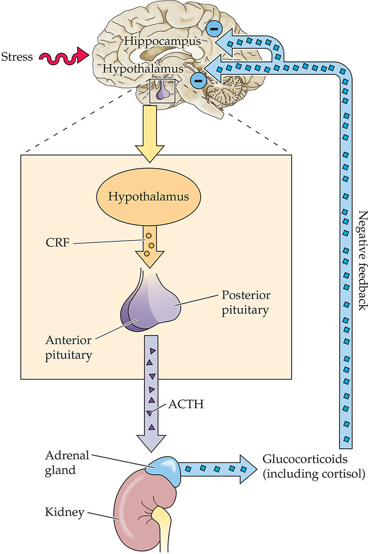
Generalized Anxiety Disorder (GAD)
HPA axis
By Garrett Brownlee
Description:
Chronic condition characterized by excessive, pervasive, and uncontrollable apprehensive expectation (worry) across multiple domains of life, occurring more days than not for 6 months or longer
Common Symptoms:
-Muscle tension**
-Restlessness (feeling “on edge”)
-Difficulty concentrating
-Easily fatigued
-Irritability
-Sleep disturbances
-Excessive worrying
Cause: Dysfunction in Nervous System
1. Failure of top-down PFC-Amygdala control
2. HPA-Axis dysregulation (the dual-phase model)

Slide 2
References
Elnazer, H. Y. (2026). A dual-stage model of hypothalamic-pituitary-adrenal (HPA) axis dysregulation in anxiety disorders: A systematic review. Psikiyatride Güncel Yaklaşımlar- Current Approaches in Psychiatry, 18(4), 1421-1438.
Gkintoni, E., & Suárez Ortiz, P. (2023). Neuropsychology of generalized anxiety disorder in clinical setting: A systematic evaluation. Preprints.org.
Liu, X., Klugah-Brown, B., Zhang, R., Chen, H., Zhang, J., & Becker, B. (2022). Pathological fear, anxiety and negative affect exhibit distinct neurostructural signatures: Evidence from psychiatric neuroimaging meta-analysis. Translational Psychiatry, 12, 405.
Makovac, E., Meeten, F., Watson, D. R., Herman, A., Garfinkel, S. N., Critchley, H. D., & Ottaviani, C. (2016). Alterations in amygdala-prefrontal functional connectivity account for excessive worry and autonomic dysregulation in generalized anxiety disorder. Biological Psychiatry, 80(10), 786-795.
Patriquin, M. A., & Mathew, S. J. (2017). The neurobiological mechanisms of generalized anxiety disorder and chronic stress. Chronic Stress, 1, 2470547017703993.

